Slide 1

Data as a Signal Data X: A Course on Data, Signals, and Systems
Data ^{X}
About Me:
Ikhlaq Sidhu Chief Scientist & Founding Director, Sutardja Center for Entrepreneurship & Technology IEOR Emerging Area Professor Award, UC Berkeley

Slide 2
Outline for Data as a Signal Part II
Fourier and Spectral Analysis
Comb Function, and why this is so important
Resampling

Slide 3
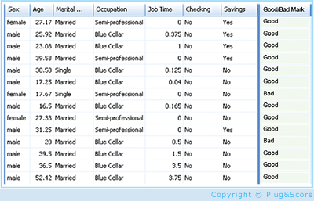
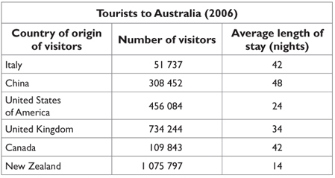
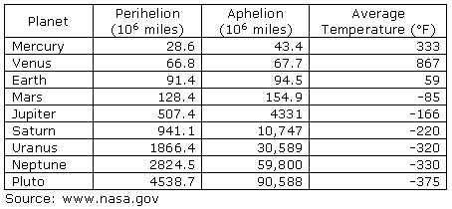
Part II: LTI and Data Signals to Features
Features, but also loss of information
In Real Life
Objects
Events/Experiments
People/Customers
Products
Stocks
…
Person 1
Person 2
Person 3
.
.
.
Person N
In Sample
Out of Sample
Time Varying Signals to Features
Characteristics
Patterns
Models
Predictions
Similarities
Differences
Distance

Slide 4
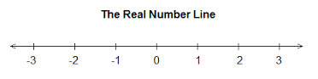
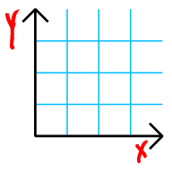
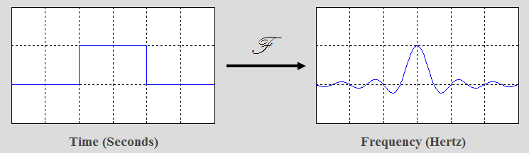
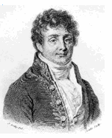
Fourier Transform The most famous of mathematical transforms
f(x)
g(x)
x
y = f(x) = x+1
f()
y
A Transform is not a function: ie mapping from one variable to another
Notes:
Functions can be 1:1, and onto

Slide 5
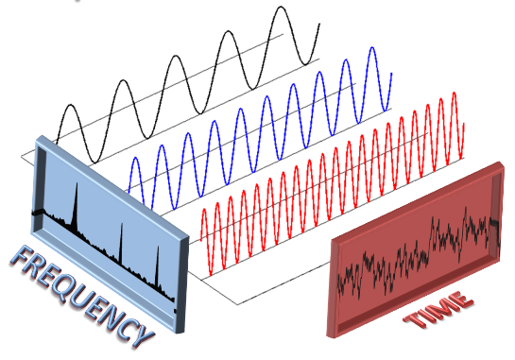
Fourier Transform
Mapping from a time
to frequency, and back.
groups.csail.mit.edu/netmit/wordpress/projects/sparse-fourier-transform/

Slide 6
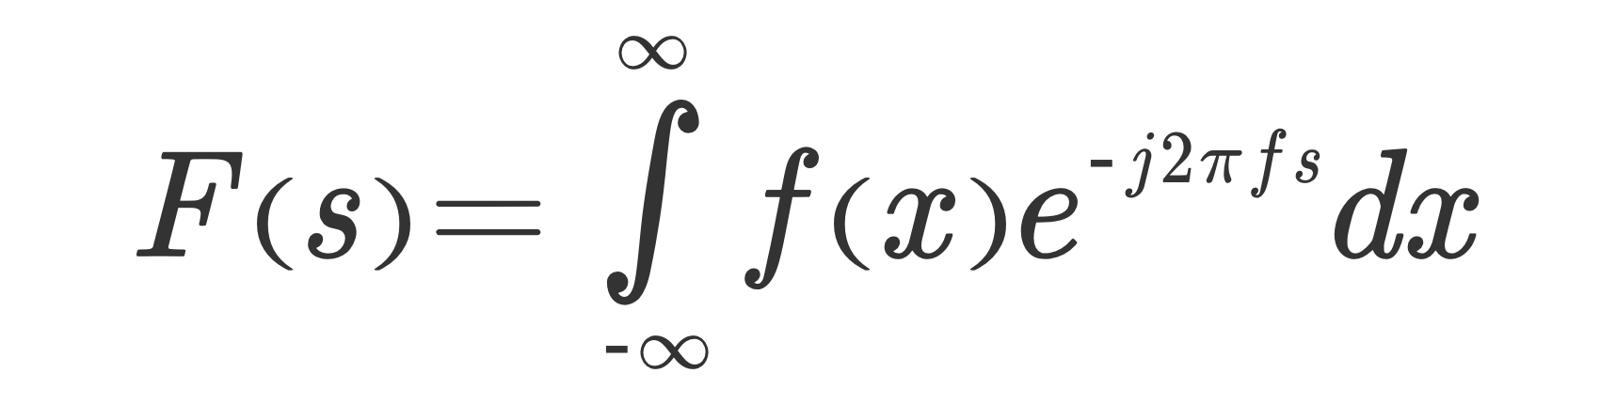
In more detail
x or t = time, f(x) is a function of time
i or j are for imaginary numbers. Note F and f are both complex functions.
f or s is often used for frequency, so F(s) is a function in frequency
Integrate (average) over all time (for every given frequency)

Slide 7

In more detail
Remember that

Slide 8
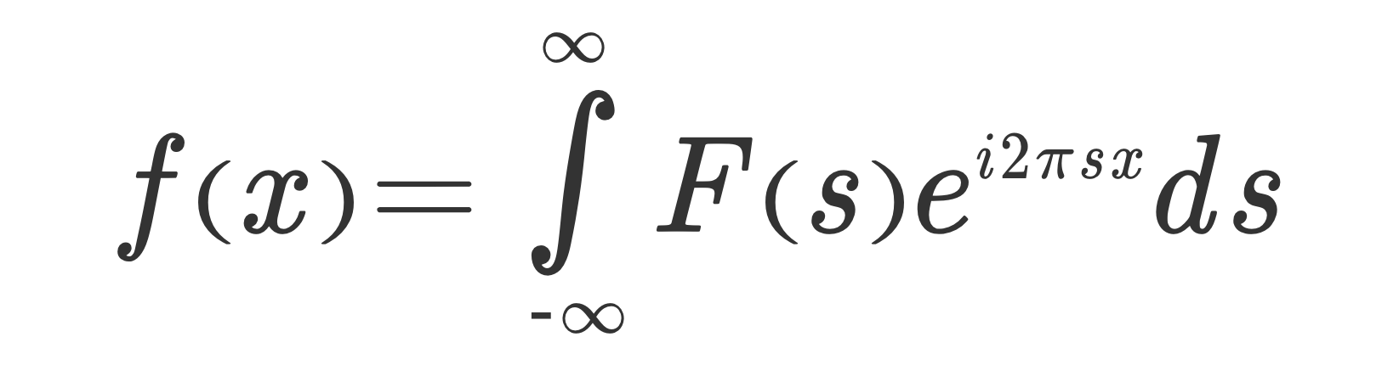
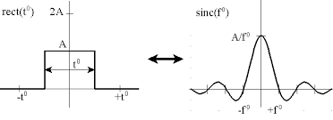
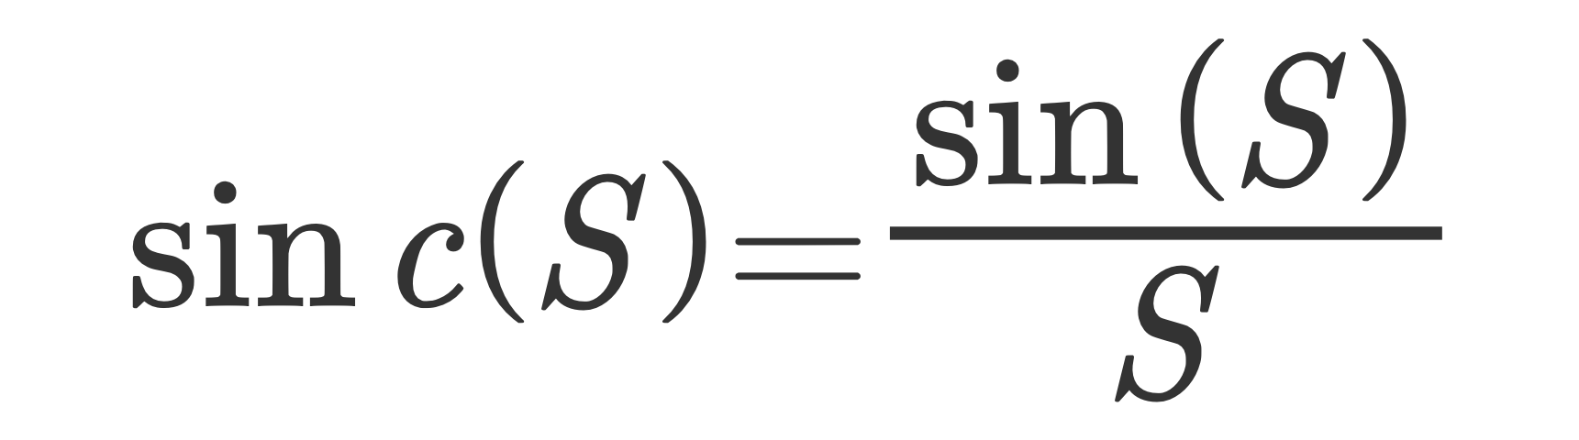
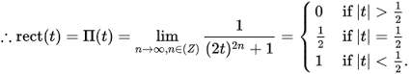
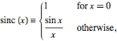
Fourier Basics
This example is the famous rect(x) which transforms to Sinc(s)
S=f in the graph
http://www.thefouriertransform.com/

Slide 9
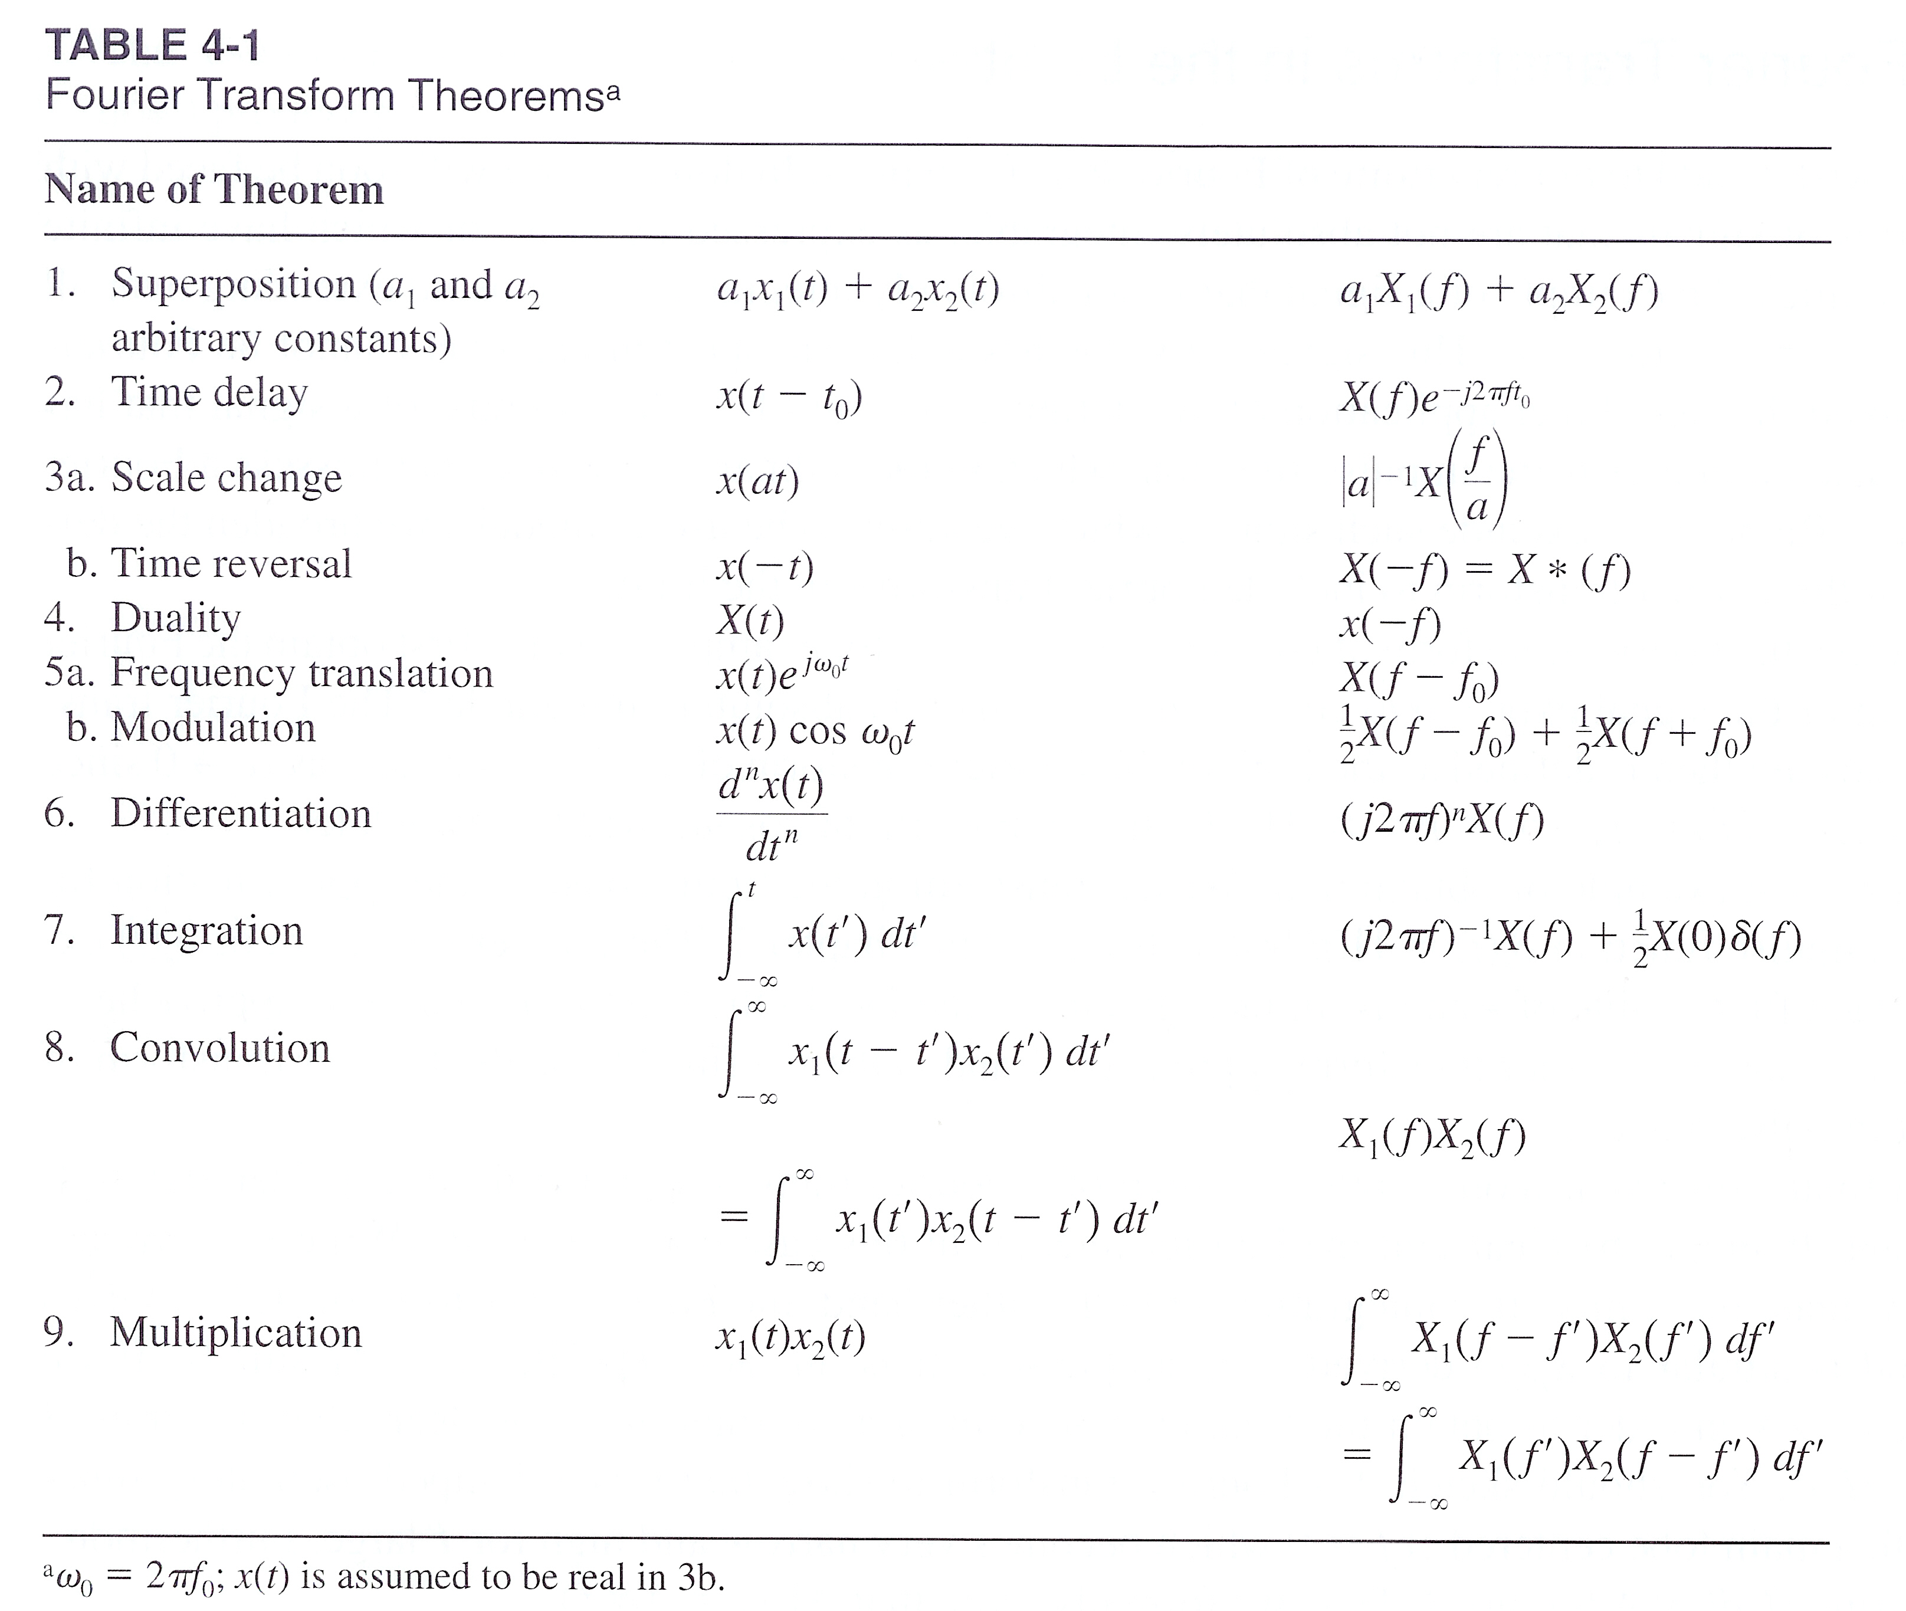
As written in virtually every book on Fourier or Systems..

Slide 10
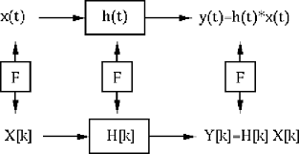
And of course, there is a famous link between Fourier, LTI, and Convolution:

Slide 11
So that’s all great, but what about data?
>>> from scipy.fftpack import fft, ifft
>>> x = np.array([1.0, 2.0, 1.0, -1.0, 1.5])
>>> y = fft(x)
>>> y
array([ 4.50000000+0.j , 2.08155948-1.65109876j,
-1.83155948+1.60822041j, -1.83155948-1.60822041j,
2.08155948+1.65109876j])
>>> yinv = ifft(y)
>>> yinv
array([ 1.0+0.j, 2.0+0.j, 1.0+0.j, -1.0+0.j, 1.5+0.j])

Slide 12
So that’s all great, but what about data?
>>> np.fft.fft(np.exp(2j * np.pi * np.arange(8) / 8))
array([ -3.44505240e-16 +1.14383329e-17j,
8.00000000e+00 -5.71092652e-15j,
2.33482938e-16 +1.22460635e-16j,
1.64863782e-15 +1.77635684e-15j,
9.95839695e-17 +2.33482938e-16j,
0.00000000e+00 +1.66837030e-15j,
1.14383329e-17 +1.22460635e-16j,
-1.64863782e-15 +1.77635684e-15j])

Slide 13
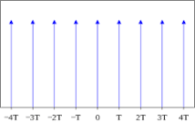
But wait, that was discrete, and Fourier was continuous
This is the comb function:

Slide 14
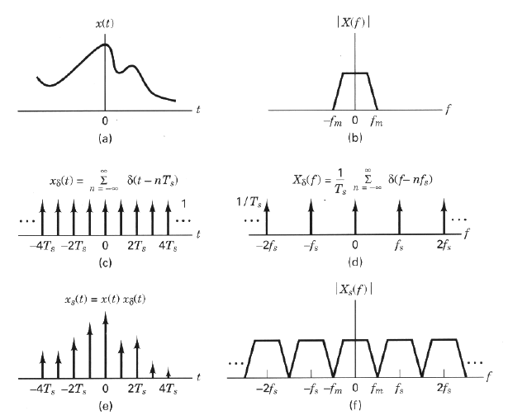
By understanding the properties of the Comb, we can map between the time signal and the frequency samples
Sampled with time T, and with N samples means:
Each frequency bin in the FFT = 1/(T*N)
http://docs.exdat.com/docs/index-44055.html

Slide 15
Code Examples
FFT of weather data
Find the timing cycles
Comments:
Note fft(0) = mean f(t)
f(0) = mean FFT(s)

